Slide 1

Bourelou Evangelia
June 2018
PROJECT
Modelling of 3D flow around a Blended Wing Body (BWB) Unmanned Aerial Vehicle (UAV)
(ANSYS CFX Student License)
ARISTOTLE UNIVERSITY OF THESSALONIKI
FACULTY OF ENGINEERING
DEPARTMENT OF MECHANICAL ENGINEERING

Slide 2

Contents
Summary
Conceptual design of a Blended Wing Body (BWB) Medium-Altitude Long-Endurance (MALE) Unmanned-Aerial-Vehicle (UAV)
Modelling scope & Boundary conditions
Boundaries and mesh around the UAV
Results
  Mach 0.1
  Mach 0.7
  Mach 0.8
  Mach 0.9
Diagrams of C_{L} - Mach number & C_{D} - Mach number
Conclusions

Slide 3
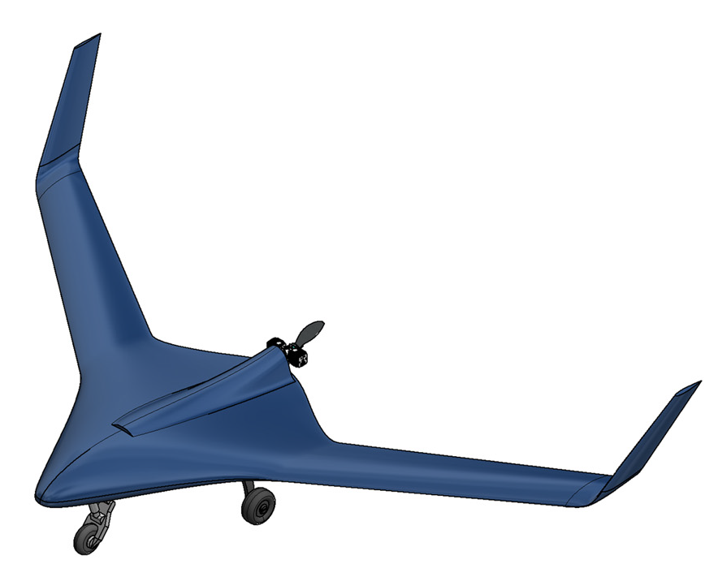
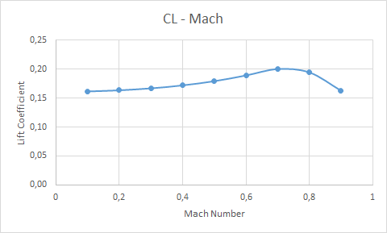
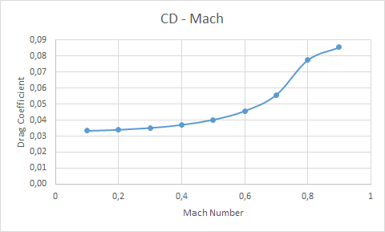
Summary
In this study, the 3D flow around a Blended Wing Body UAV is modelled, for Mach numbers varying from 0.1 M to 0.9 M.
The purpose is to calculate the Lift and Drag Coefficients of the UAV at each Mach number and to spot when and where supersonic speed appears.
Figure 2. C_{L} against Mach number.
Figure 1. Conceptual design of the BWB UAV.
Figure 3. C_{D} against Mach number.

Slide 4
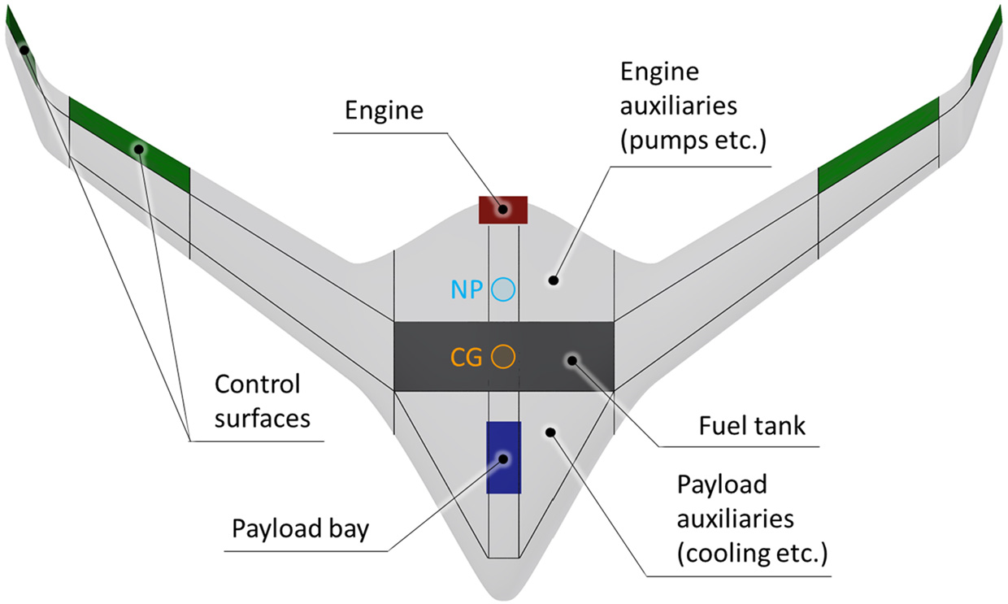
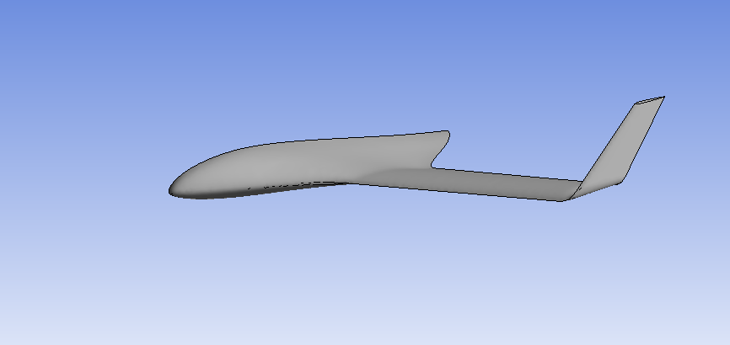
Conceptual design of a Blended Wing Body (BWB)
Medium-Altitude Long-Endurance (MALE) Unmanned-Aerial-Vehicle (UAV)
The UAV geometry is symmetrical. So, the UAV is modeled using one half of the geometry and a symmetry condition on the plane of symmetry.
The CFD analysis is conducted using the ANSYS CFX commercial software (Student License).
Figure 5. CAD representation of the BWB UAV.
Figure 4. Internal layout. The location of the fuel tank, control surfaces, engine and payload, as well as their auxiliaries, are shown, whereas the black lines are an indicative concept of the structural layout.
Figure 6. One half of the symmetrical simplified UAV geometry, used for the modelling of the UAV with ANSYS CFX.

Slide 5
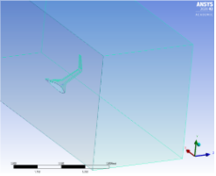
Modelling scope & Boundary conditions
Flight altitude: 30000 ft
  Temperature at 30000 ft: -44.35 °C
  Sound velocity at 30000 ft: a = 303.23 m/s
Mach number: 0.1, 0.2, 0.3, 0.4, 0.5, 0.6, 0.7, 0.8, 0.9 M
  This range of Mach numbers indicates that the results will include incompressible and compressible flow.
Angle of attack: 0
Inlet air velocity: v = a * Ma
The solution will assume ideal flow, without finer mesh on the walls.
  Turbulence model: option ‘laminar’
  Walls: option ‘free slip wall’
  Very low dynamic viscosity
  Inlet: front wall
  Outlet: rear wall, where
  Relative Static Pressure = 30150.77 Pa
  All other surfaces of the control volume are considered to be planes of symmetry.
Figure 7. Image of the UAV geometry (surfaces) inside the boundaries.

Slide 6
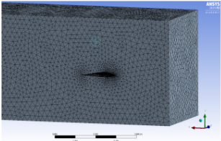
Boundaries and mesh around the UAV
The boundaries around the UAV are:
  -X: 5m, +X: 12m,
  -Y: 4m, +Y: 4m,
  -Z: 4m, +Z: 4m
An unstructured grid is generated around the configuration, using ‘inflation’ around the body’s surfaces.
Figure 7. Image of the UAV geometry (surfaces) inside the boundaries.
Figure 8. Image of the generated mesh around the UAV on the plane of symmetry.

Slide 7
Results
The results for Mach numbers 0.1, 0.7, 0.8, 0.9 are presented, including:
  Velocity, Pressure and Mach number isolines,
  Pressure isolines at the upper and lower surface,
  Velocity vectors,
At Mach > 0.7, shock waves appear on the surface of the UAV.
Finally, diagrams of the Lift and Drag Coefficients against Mach number are presented.

Slide 8
Results
Mach 0.1
(incompressible flow)

Slide 9
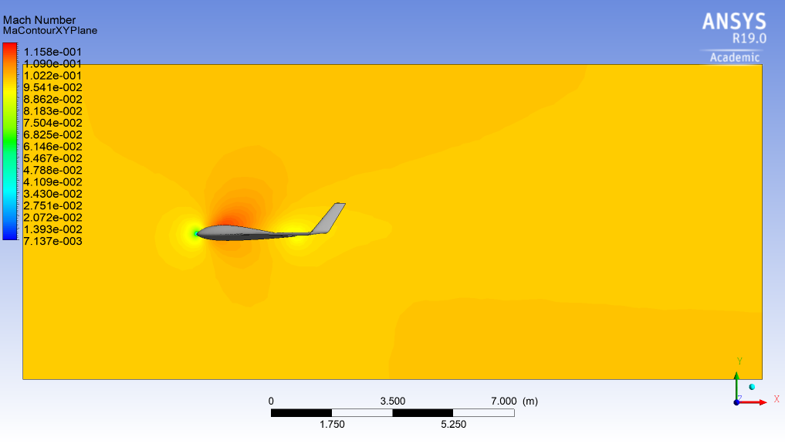
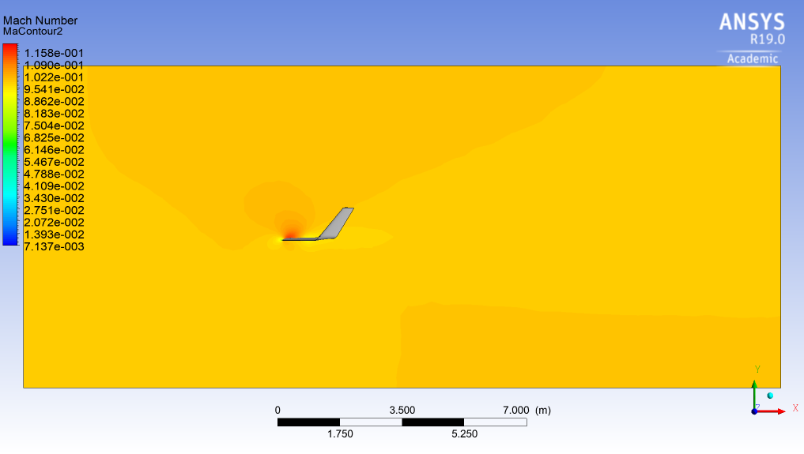
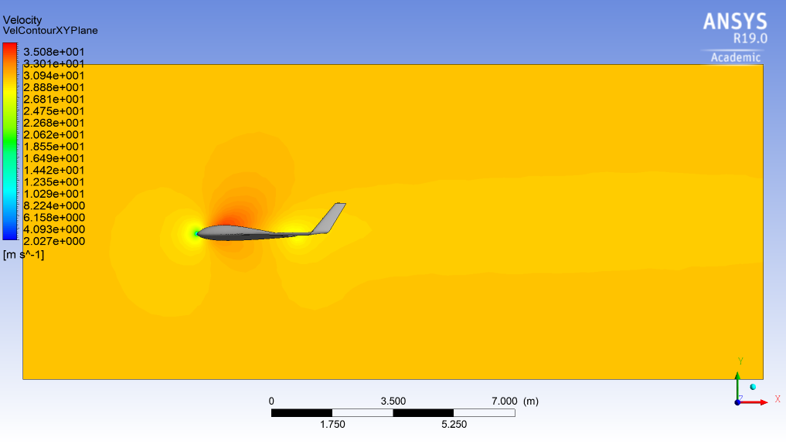
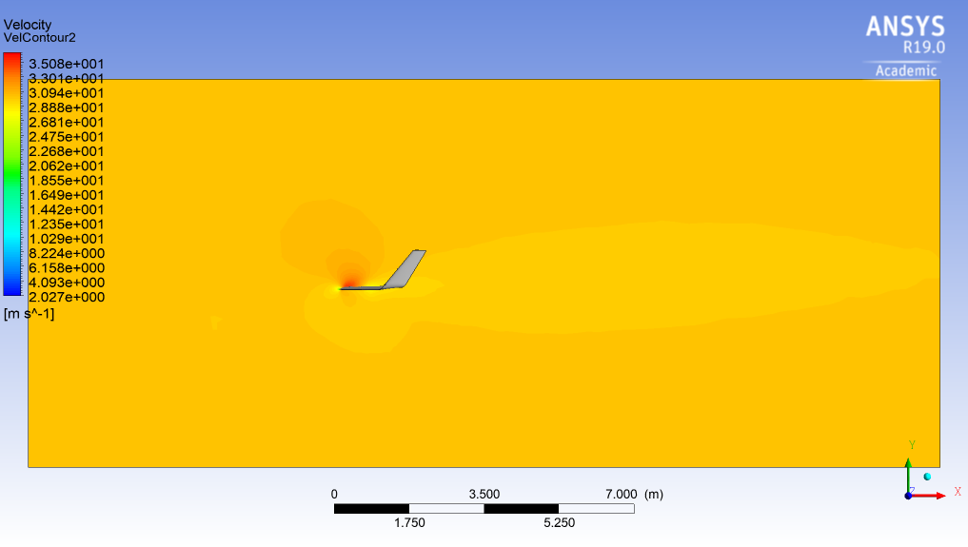
Mach 0.1, v = 30.32 m/s – Mach & Velocity
Figure 9. Mach number isolines at the plane of symmetry (0.1M).
Figure 10. Mach number isolines 2m away from the plane of symmetry (0.1M).
Figure 11. Velocity isolines at the plane of symmetry (0.1M).
Figure 12. Velocity isolines 2m away from the plane of symmetry (0.1M).

Slide 10
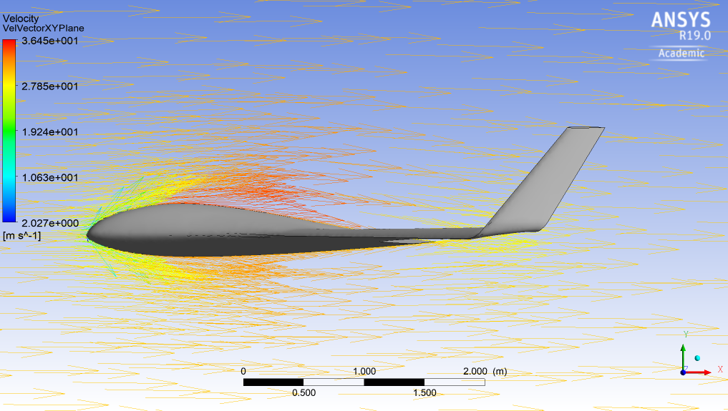
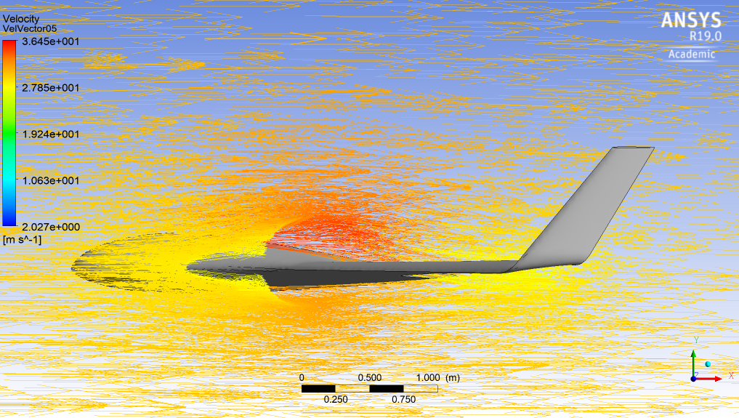
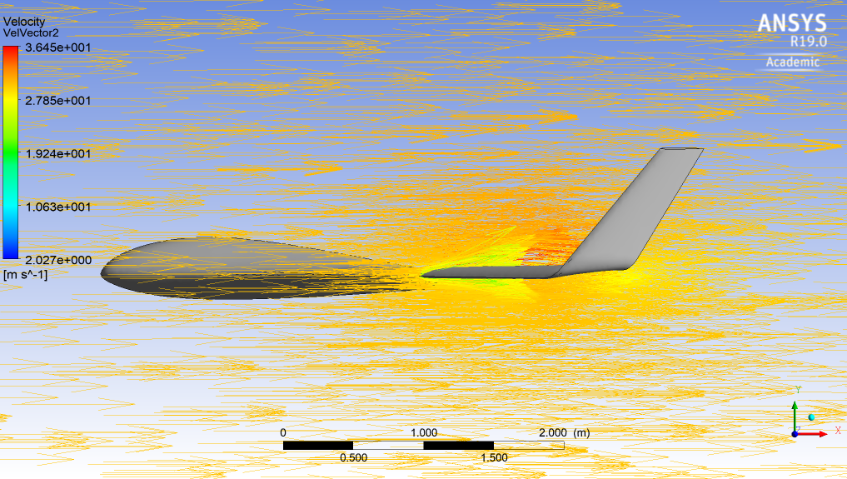
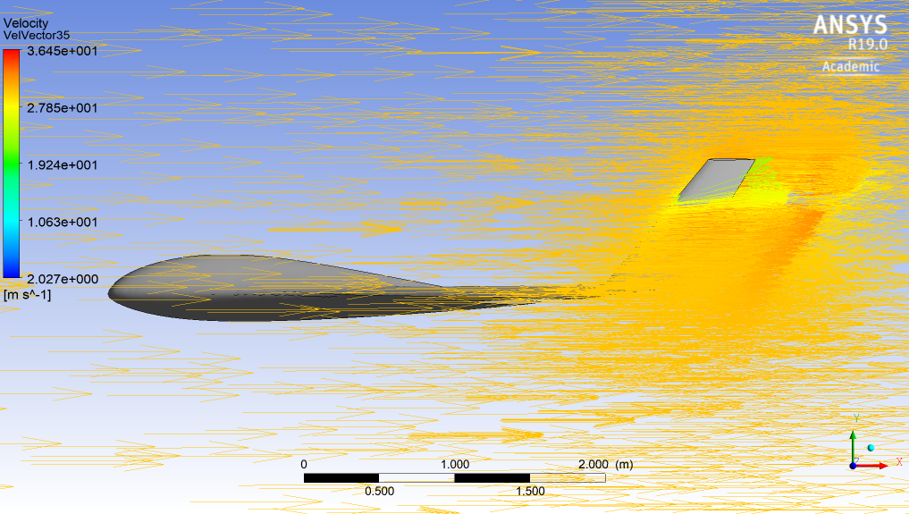
Mach 0.1, v = 30.32 m/s – Velocity vectors
Figure 13. Velocity vectors at the plane of symmetry (0.1M).
Figure 14. Velocity vectors 0.5 m away from the plane of symmetry (0.1M).
Figure 15. Velocity vectors 2m away from the plane of symmetry (0.1M).
Figure 16. Velocity vectors 3.5 m away from the plane of symmetry (0.1M).

Slide 11
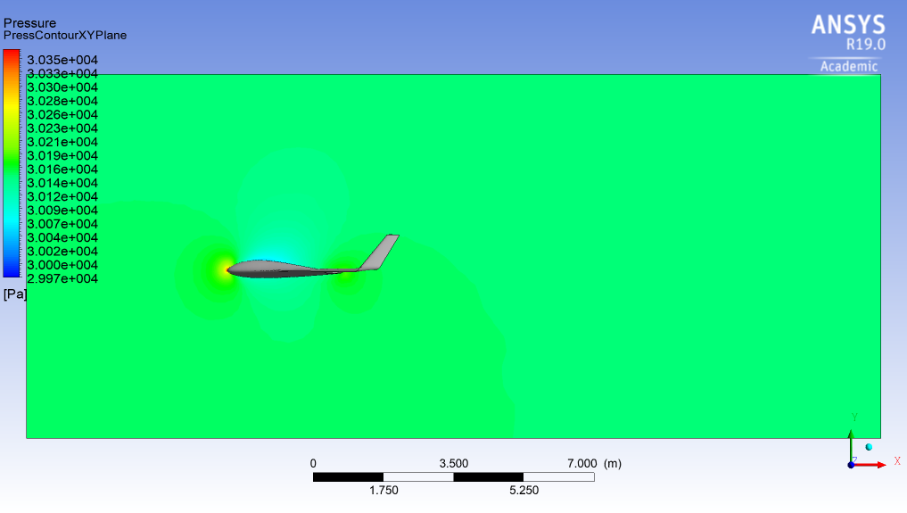
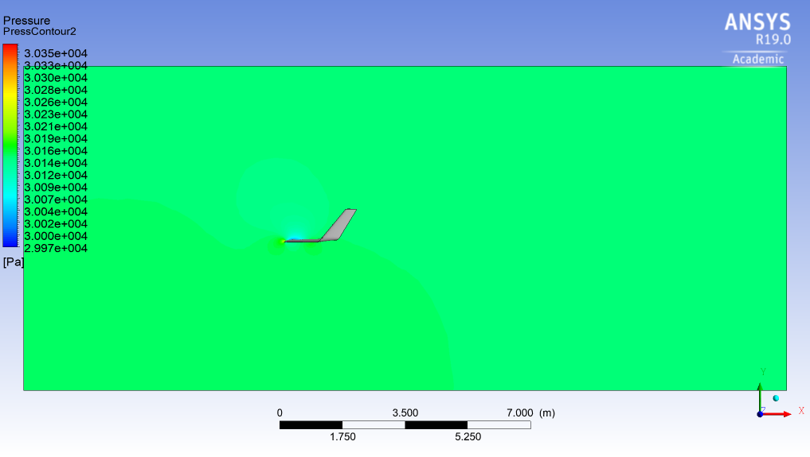
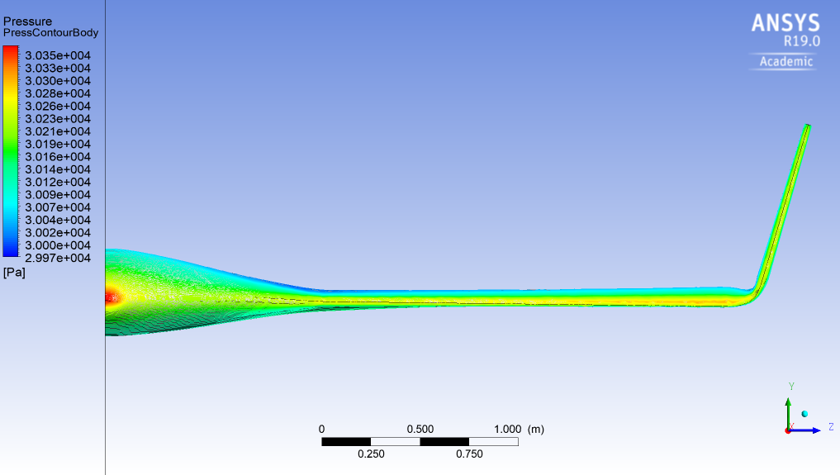
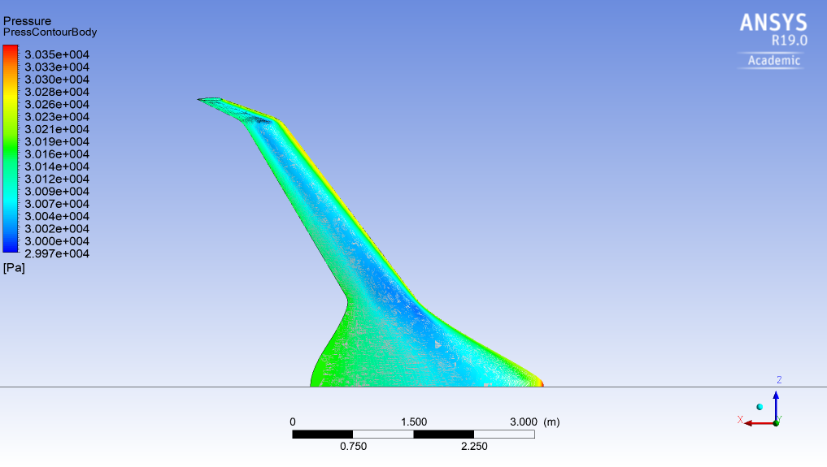
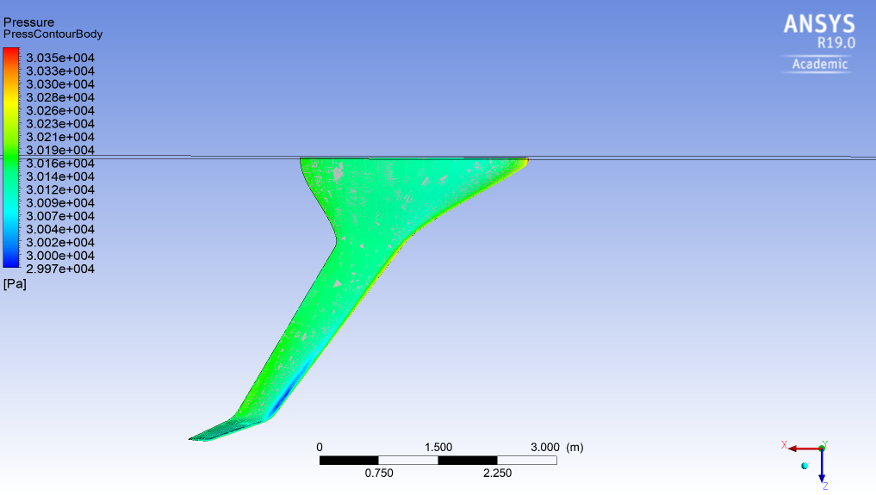
Mach 0.1, v = 30.32 m/s – Pressure
Figure 17. Pressure isolines at the plane of symmetry (0.1M).
Figure 18. Pressure isolines 2m away from the plane of symmetry (0.1M).
Figure 19. Pressure contour at the front, on the upper surface and on the lower surface (0.1M).

Slide 12
Results
Mach 0.7
(incompressible flow)

Slide 13
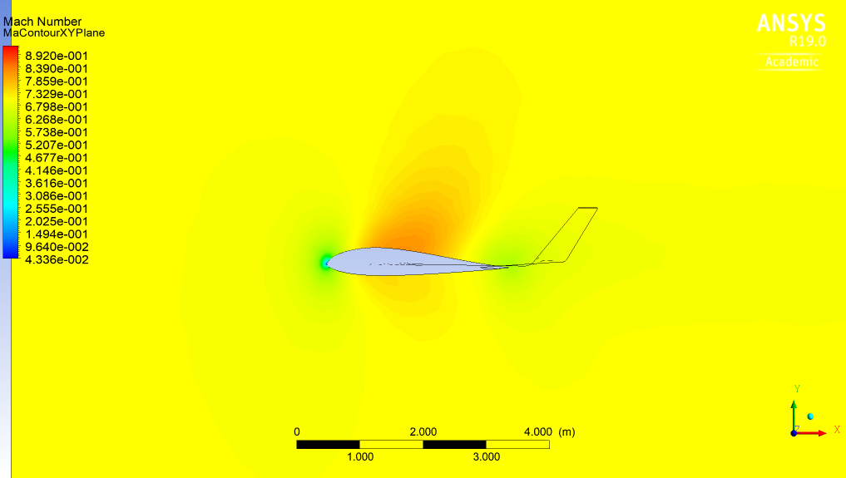
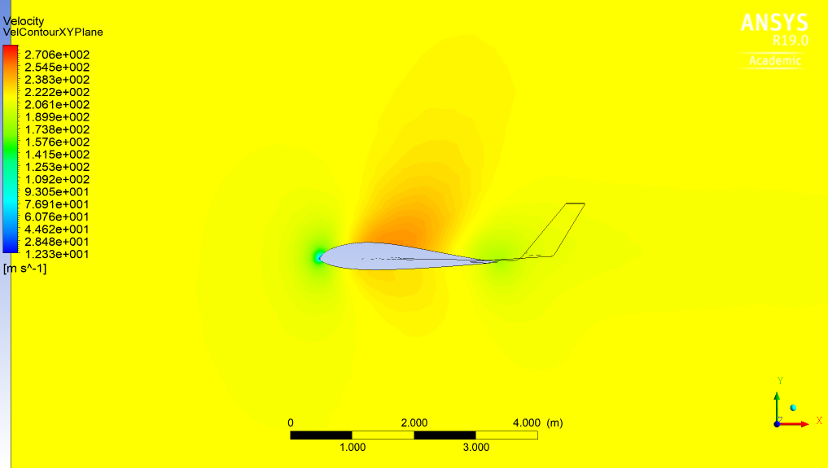
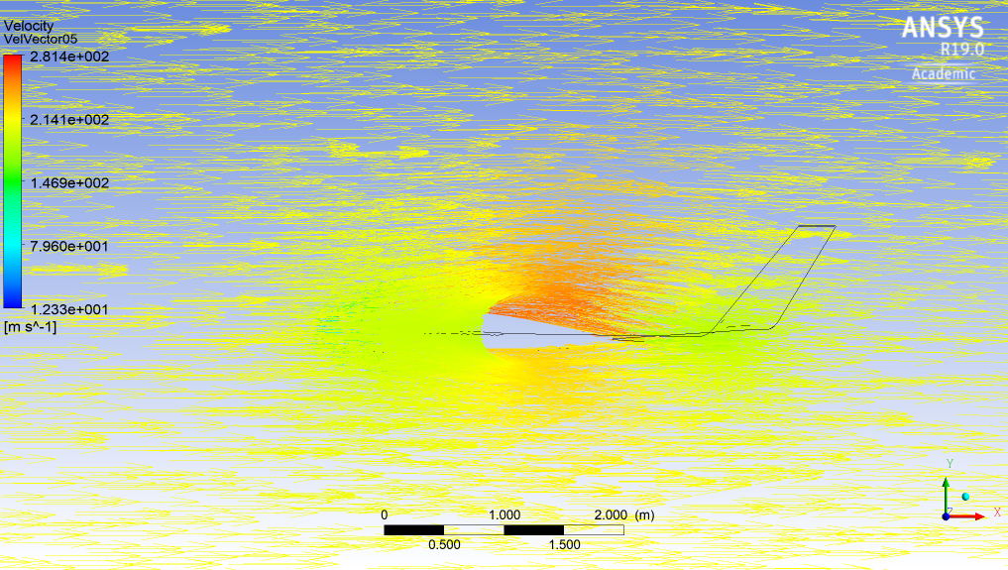
Mach 0.7, v = 212.26 m/s – Mach & Velocity
Figure 20. Mach number isolines at the plane of symmetry (0.7M).
Figure 21. Velocity isolines at the plane of symmetry (0.7M).
Figure 22. Velocity vectors 0.5 m away from the plane of symmetry (0.7M).

Slide 14
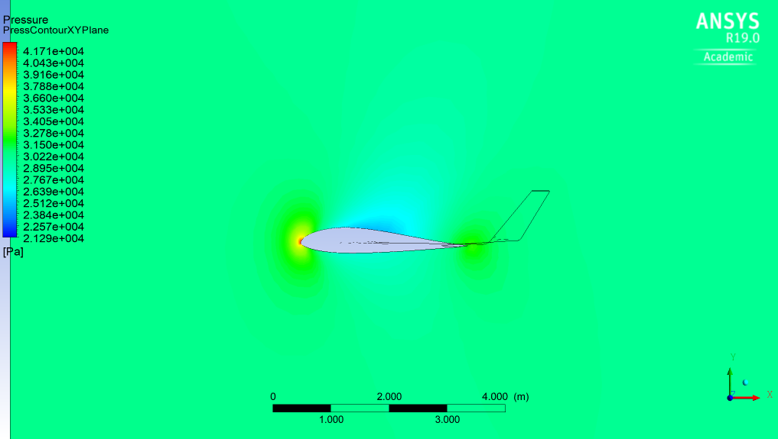
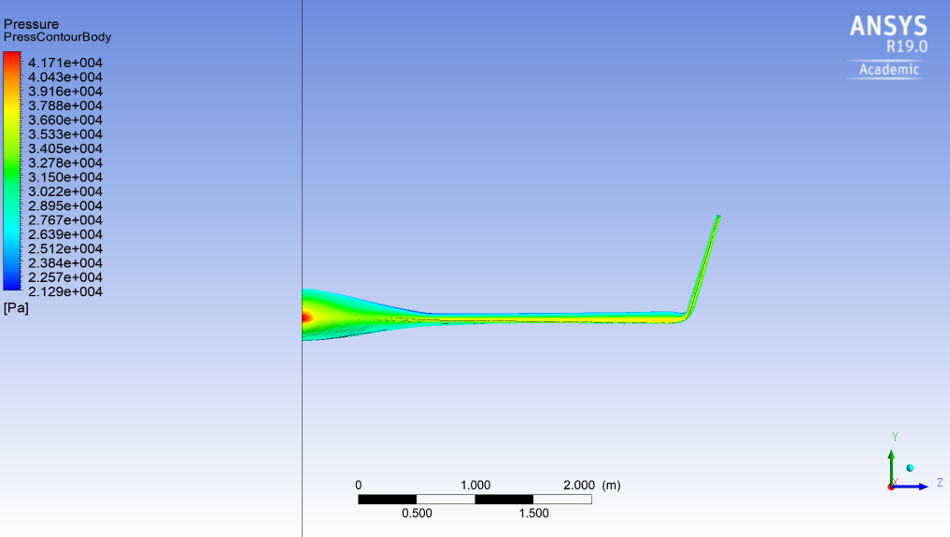
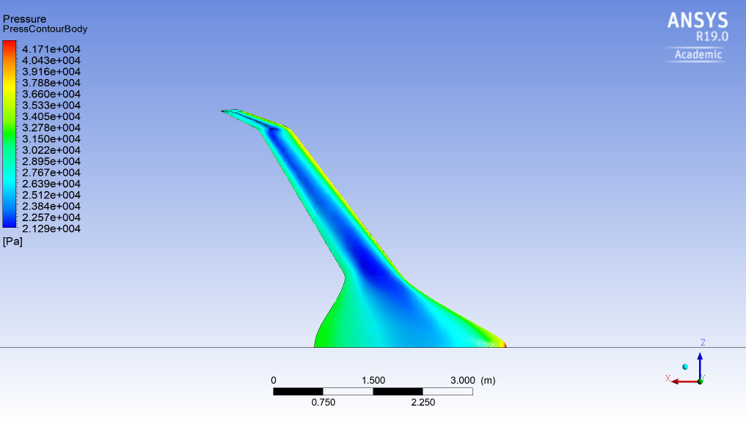
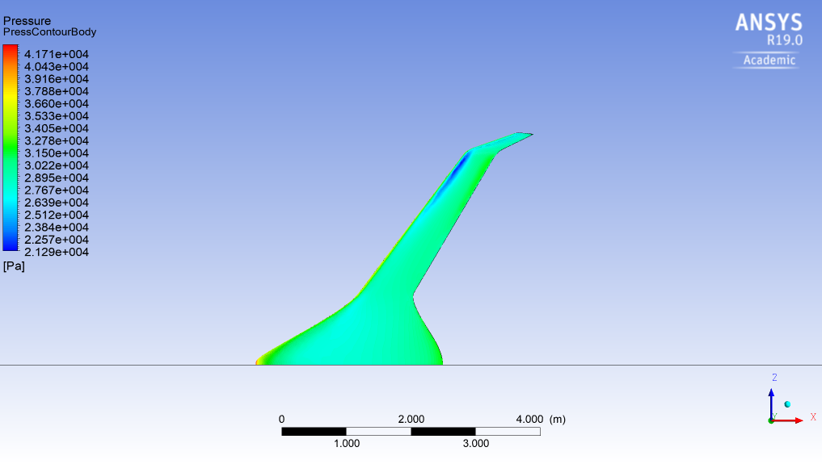
Mach 0.7, v = 212.26 m/s – Pressure
Figure 23. Pressure isolines at the plane of symmetry (0.7M).
Figure 24. Pressure contour at the front, on the upper surface and on the lower surface (0.7M).

Slide 15
Results
Mach 0.8
(compressible flow)

Slide 16
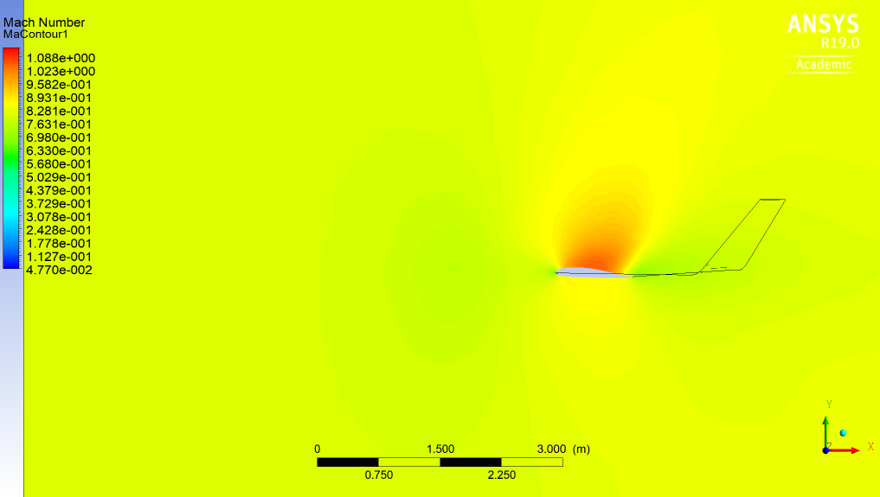
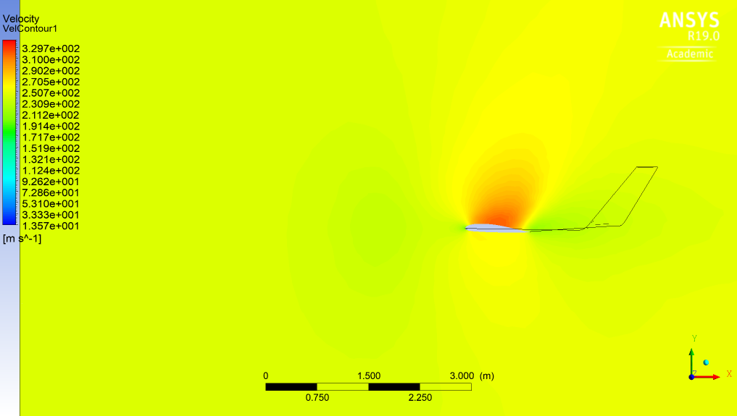
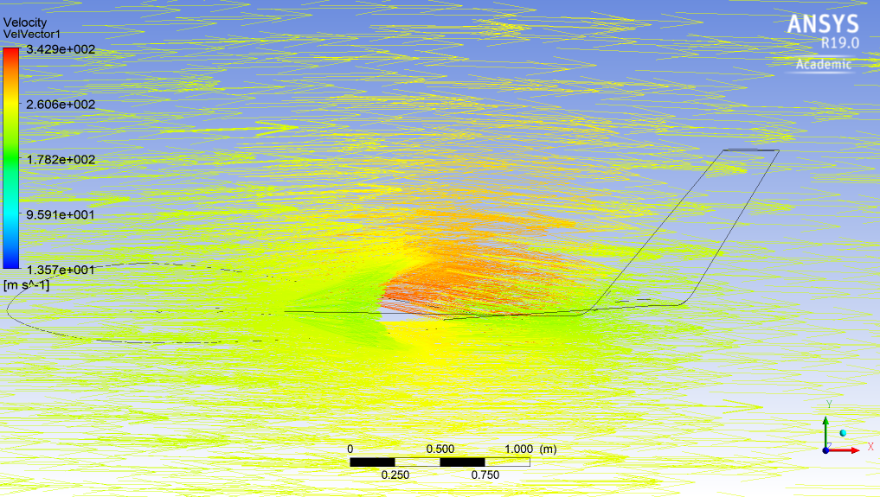
Mach 0.8, v = 242.58 m/s – Mach & Velocity
Figure 25. Mach number isolines 1 m away from the plane of symmetry (0.8M).
Figure 26. Velocity isolines 1 m away from the plane of symmetry (0.8M).
At Mach 0.9, supersonic speed is observed above the wing, 1 m away from the plane of symmetry.
Figure 27. Velocity vectors 1 m away from the plane of symmetry (0.8M).

Slide 17
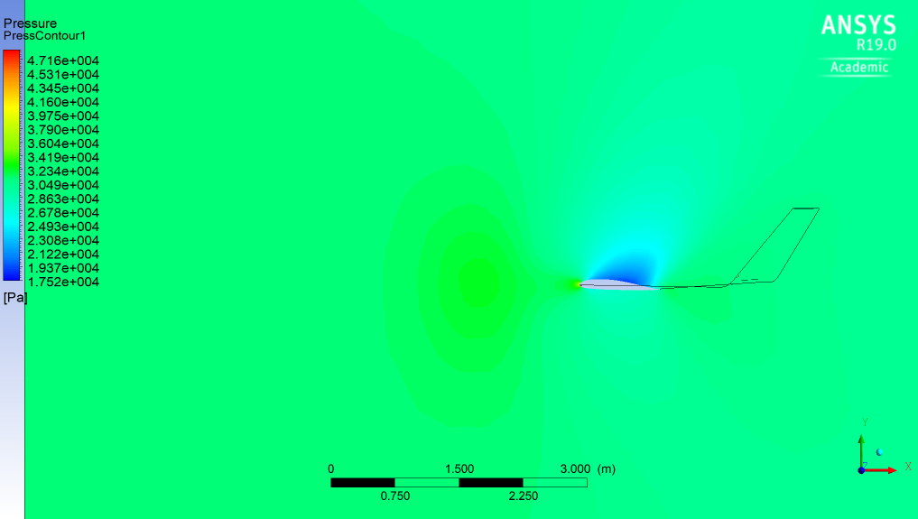
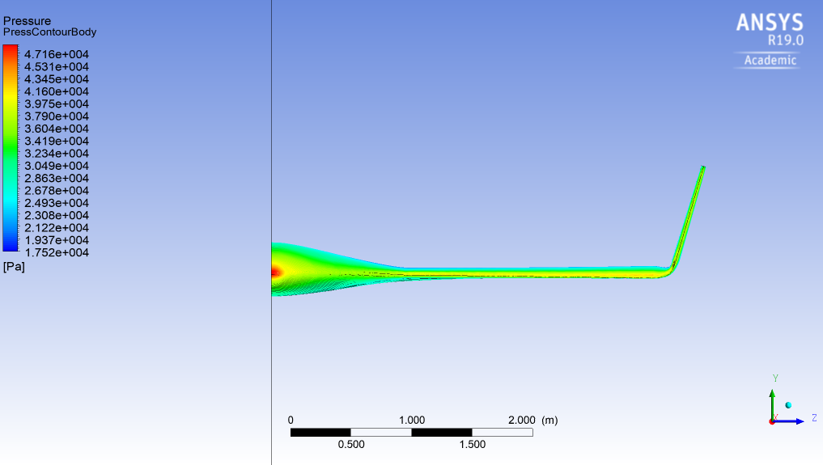
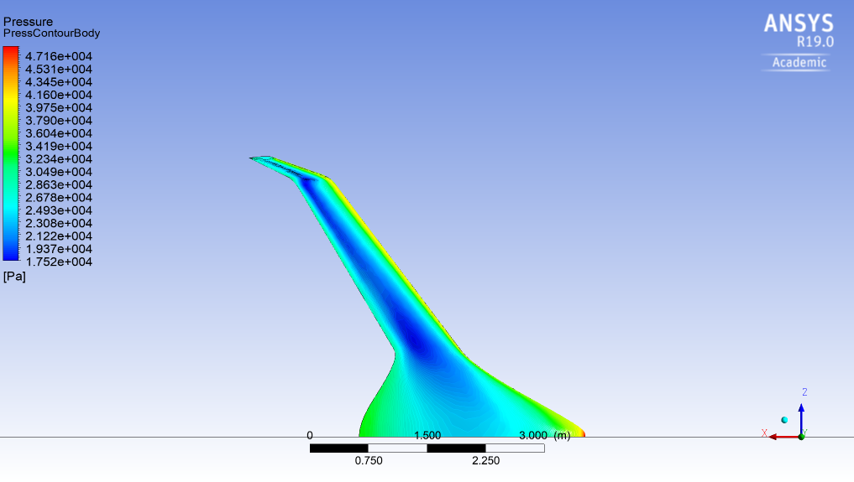
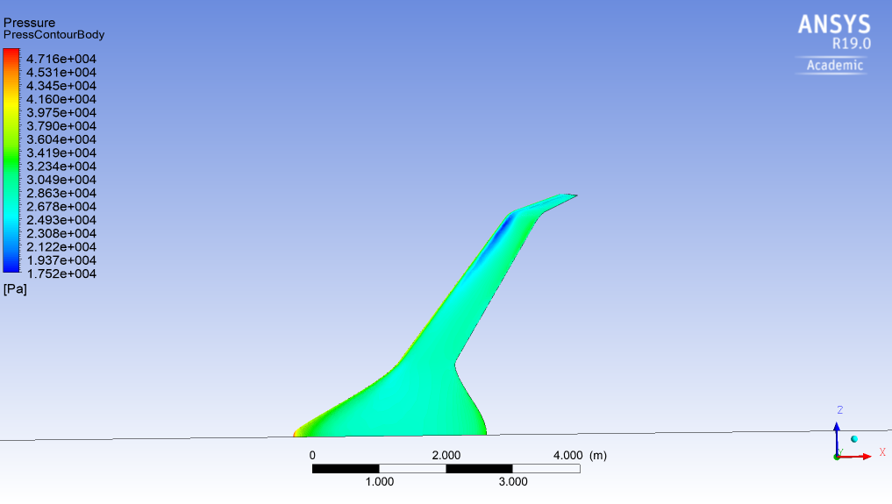
Mach 0.8, v = 242.58 m/s – Pressure
Figure 28. Pressure isolines 1 m away from the plane of symmetry (0.8M).
Figure 29. Pressure contour at the front, on the upper surface and on the lower surface (0.8M).

Slide 18
Results
Mach 0.9
(compressible flow)

Slide 19
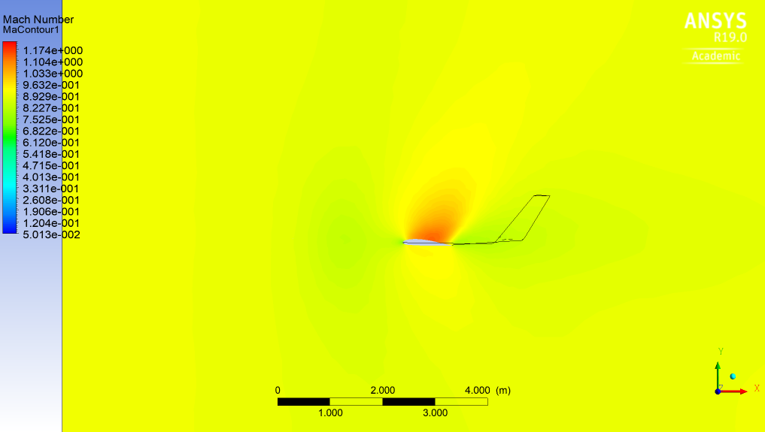
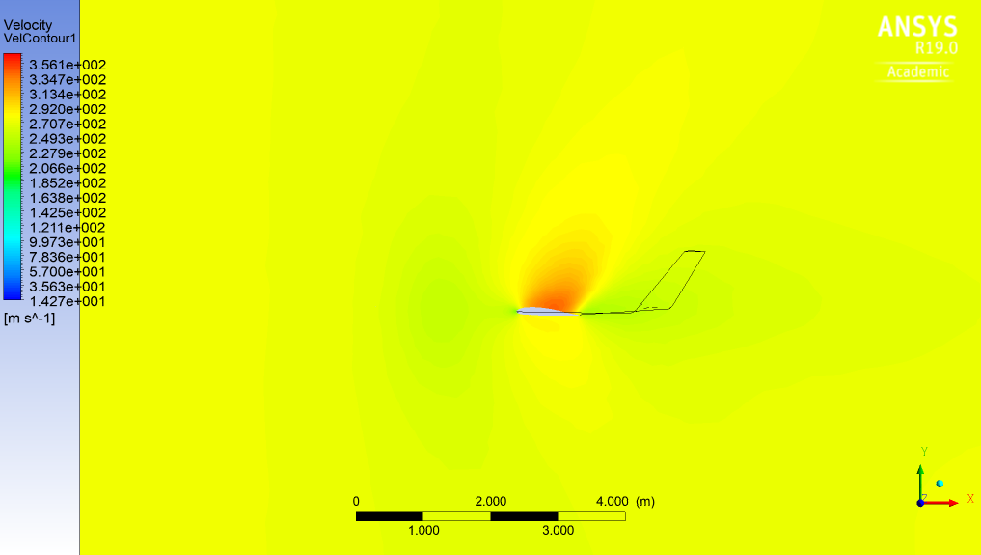
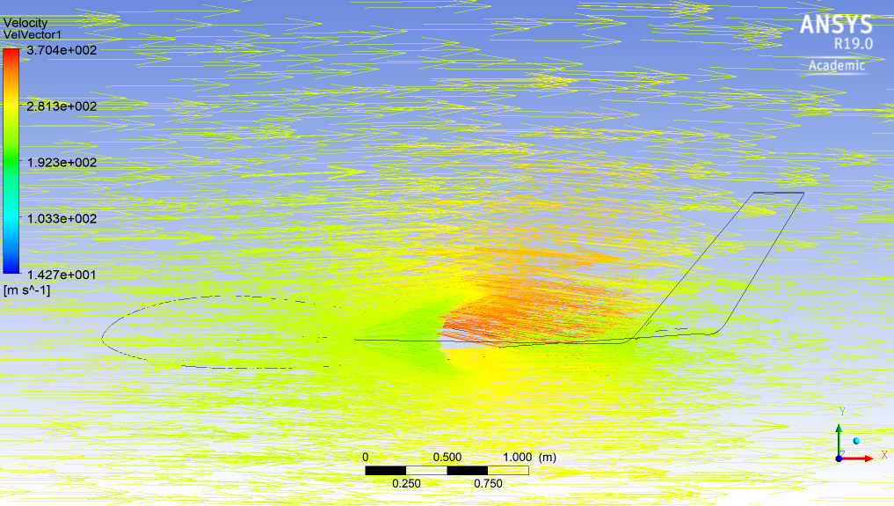
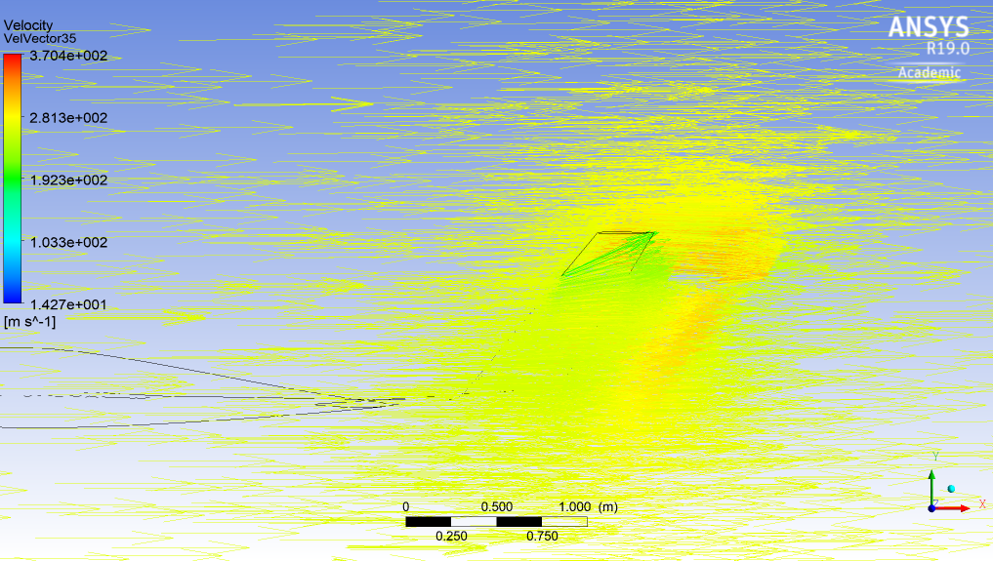
Mach 0.9, v = 272.9 m/s – Mach & Velocity
Figure 30. Mach number isolines 1 m away from the plane of symmetry (0.9M).
Figure 31. Velocity isolines 1 m away from the plane of symmetry (0.9M).
Figure 32. Velocity vectors 1 m away from the plane of symmetry (0.9M).
Figure 33. Velocity vectors 3.5 m away from the plane of symmetry (0.9M).
At Mach 0.9, supersonic speed is observed above the wing, 1 m away from the plane of symmetry.

Slide 20
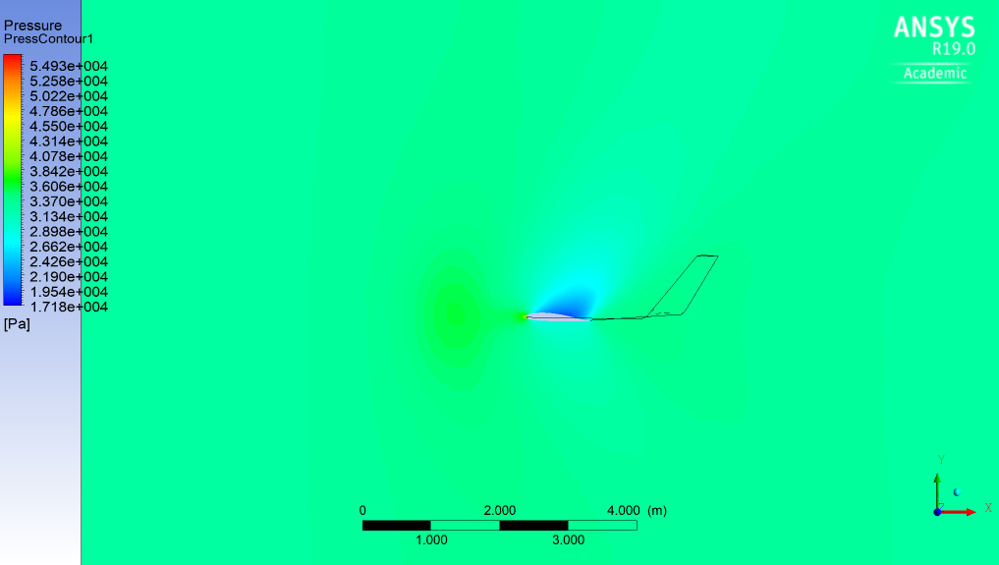
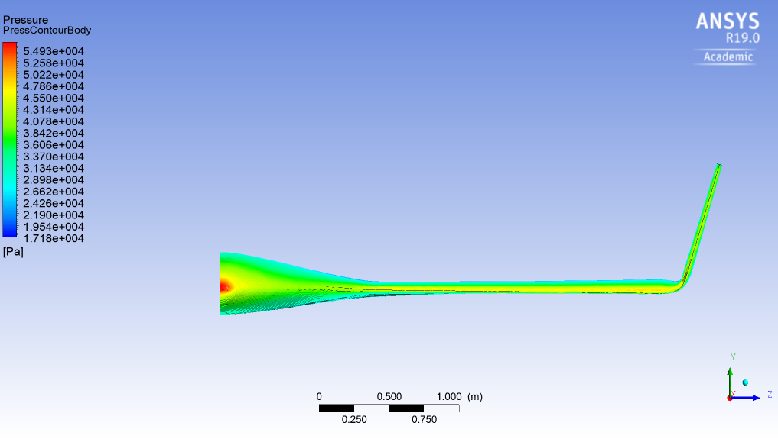
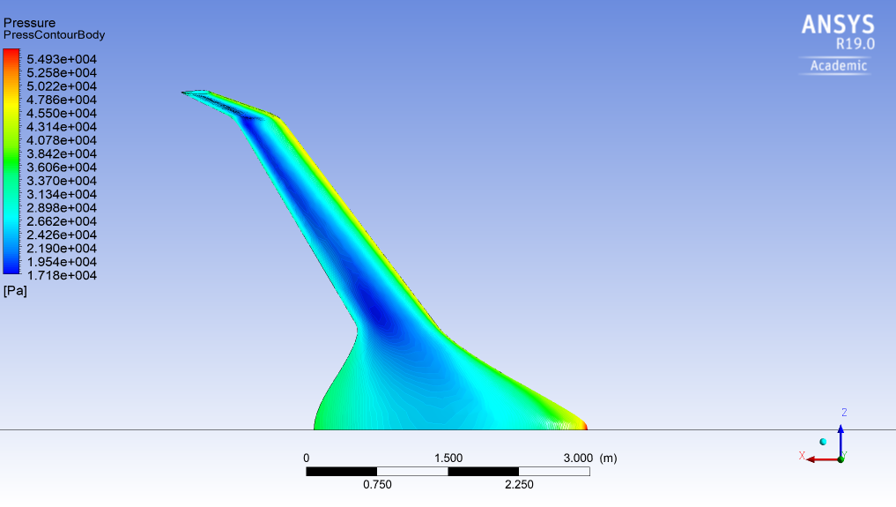
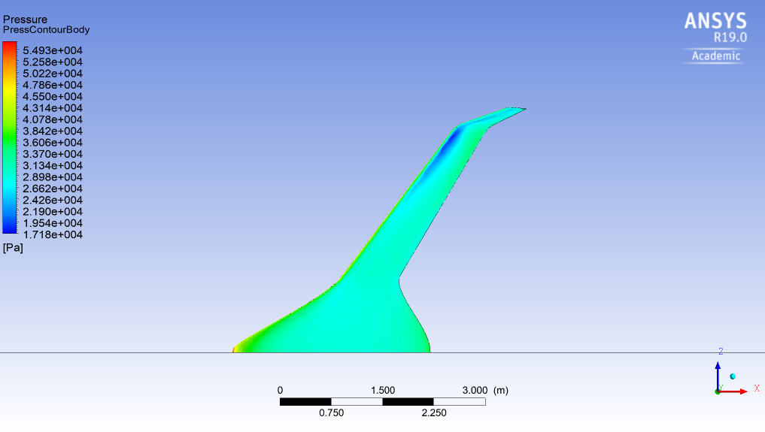
Mach 0.9, v = 272.9 m/s – Pressure
Figure 34. Pressure isolines 1 m away from the plane of symmetry (0.9M).
Figure 35. Pressure contour at the front, on the upper surface and on the lower surface (0.9M).

Slide 21
Diagrams of CL - Mach number & CD - Mach number
Figure 36. CL against Mach number.
C_{L} = L/(0.5*rho*v²*A).
Figure 37. CD against Mach number.
C_{D} = D/(0.5*rho*v²*A).
The ‘drag divergence Mach number’ is the Mach number above which C_{D} increases rapidly (usually above 0.6 M).
The rapid increase of C_{D} occurs due to the appearance of shock waves on the wing’s surface, which can induce flow detachment and positive pressure gradients.
In our case, the ‘drag divergence Mach number’ is approximately 0.7 M.

Slide 22
Conclusions
A Blended Wing Body Unmanned Aerial Vehicle (UAV) was modeled using ANSYS CFX for a range of 0.1 up to 0.9 Mach.
The Lift and Drag Coefficients were calculated at each Mach number.
The drag divergence Mach number of the UAV was found to be around 0.7 Mach.
Shock waves appeared on the surface of the UAV at 0.8 and 0.9 Mach, one meter away from the plane of symmetry.

Slide 23
Bourelou Evangelia
June 2018
Thank you.
ARISTOTLE UNIVERSITY OF THESSALONIKI
FACULTY OF ENGINEERING
DEPARTMENT OF MECHANICAL ENGINEERING

